Slide 1

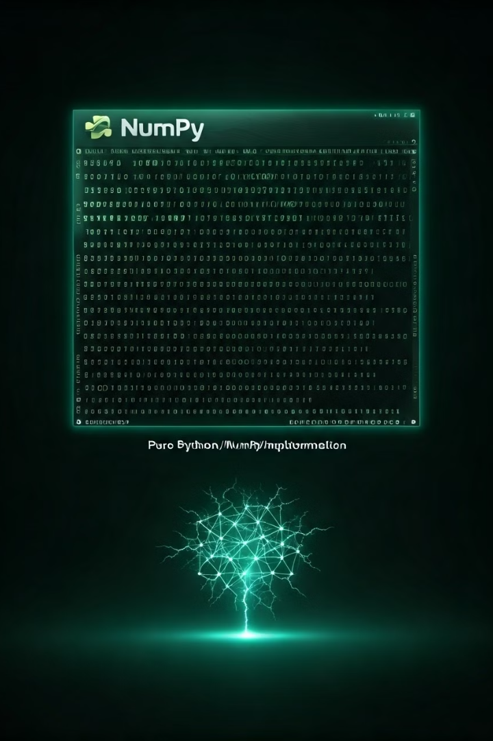
From Pixels to Predictions: MNIST Digit Recognition with NumPy
Embark on a deep learning journey to tackle handwritten digit classification using a pure Python implementation with NumPy. We demystify neural networks by building an end-to-end system from scratch. This presentation covers the implementation of a neural network for recognizing handwritten digits from the MNIST dataset, which contains 70,000 images of digits (28x28 pixels). This challenge is a cornerstone in machine learning.

Slide 2
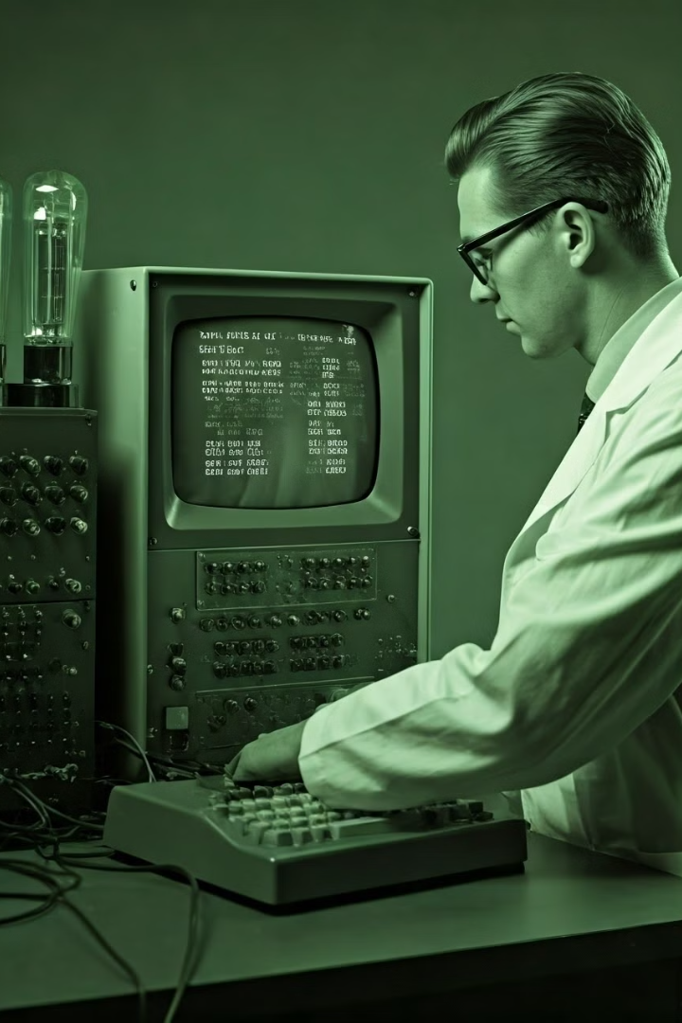



The MNIST Challenge
The MNIST dataset presents a benchmark problem in machine learning, containing 60,000 training images and 10,000 test images. It spans 10 digit classes (0-9), with a 99% accuracy benchmark for neural networks. This dataset holds historical significance in machine learning education, serving as a foundational resource for learners. The goal is to train a model that accurately classifies these images.
Training Data
Test Data
59,000 images for model training
1000 images for model evaluation
Accuracy Benchmark
99% target for neural networks

Slide 3




Neural Network Architecture
We employ a Multilayer Perceptron (MLP) architecture, featuring an input layer with 784 neurons (28x28 pixel flattening), a hidden layer with 128 neurons utilizing ReLU activation, and an output layer of 10 neurons with softmax. The network comprises approximately 100,000 trainable parameters. The input layer receives the pixel data, processes it through the hidden layer, and predicts a probability distribution over the ten digit classes.
Input Layer
Hidden Layer
Output Layer

Slide 4
Data Preprocessing Techniques
Effective data preprocessing is crucial. Techniques include pixel normalization (scaling 0-255 to 0-1 range) and one-hot encoding for labels. A proper train/test split strategy is implemented to avoid overfitting. Data augmentation techniques are considered for robust performance. Careful random weight initialization methods are used to break symmetry and improve learning.
Normalization
One-Hot Encoding
Scales pixel values to 0-1 range
Transforms labels into binary vectors

Slide 5




Forward Propagation Implementation
Forward propagation is implemented using matrix multiplication with NumPy. Activation functions, including ReLU and softmax, are coded from scratch. Computational complexity analysis is performed to optimize for efficiency. Vectorized operations are used to leverage NumPy's performance. This process feeds the input data through the network to generate predictions.
Input
1
ReLU
2
4
Output
3
Softmax

Slide 6
Backpropagation Algorithm
The backpropagation algorithm is implemented for gradient descent optimization. Weight updates are calculated using the chain rule. Learning rate tuning is essential for convergence. Strategies to prevent overfitting are applied, such as dropout or regularization. This step optimizes the network's weights based on prediction errors. By calculating gradients, the network learns from its mistakes.
1
Calculate Error
2
Compute Gradients
3
Update Weights

Slide 7
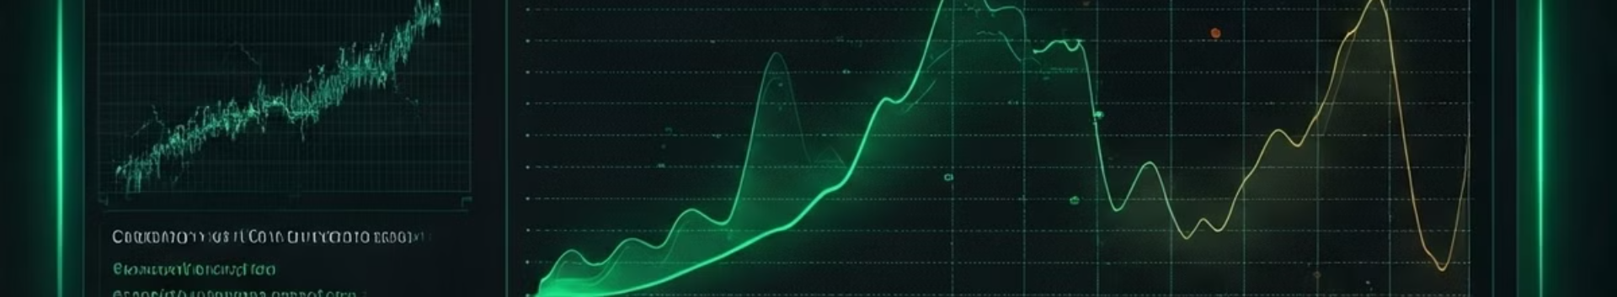



Performance Metrics
Performance is evaluated using accuracy calculation methods. A confusion matrix visualizes the classification results. Training and validation loss curves are plotted to monitor model convergence. Computational performance benchmarks are measured to assess efficiency. This comprehensive analysis validates the performance of our implementation. By evaluating loss curves and confusion matrices, we understand how well our network generalizes.
Accuracy
Confusion Matrix
Loss Curves

Slide 8
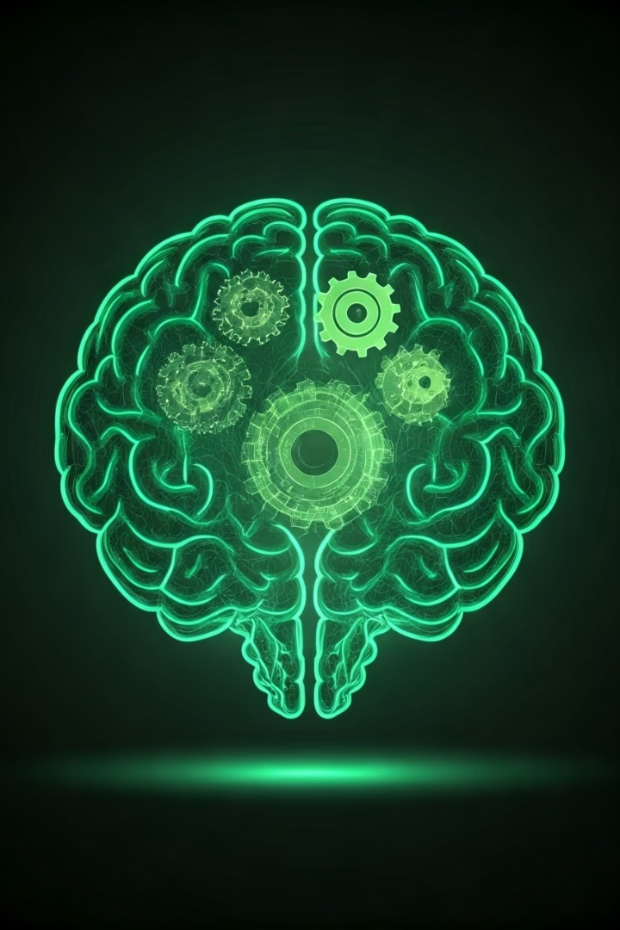
Key Takeaways
Neural networks are demystified through this project. It provides insights into pure NumPy implementations. Critical machine learning concepts are reinforced. The analysis suggests potential improvements and extensions. The importance of understanding fundamentals is highlighted. The project offers a deeper understanding of how neural networks function from the ground up.
NumPy Insights
Fundamental Concepts
Detailed NumPy neural network analysis
Deep understanding of ML principles
Future Improvements
Potential upgrades and extensions

